Slide 1
Securely Automating Infrastructure in the Cloud
By Stephen Sadowski

Slide 2
All about me...
Sr. Architect & Director, Managed Services, Olson Digital
Find me on twitter: @sj_sadowski
Or linkedin: http://www.linkedin.com/in/sjsadowski
Or email me: stephen.sadowski@icfolson.com
Or email me at my less than professional address:
stephen+cons@clyx.io
Notes:
A little on my background: 12 years as a developer, transitioned to security & systems/platform architecture, spent the last 10 years doing that

Slide 3

Expectations
Walk away saying "well, I already knew that."
For those who don't, I my hope is that there are at least no surprises.
Notes:
Gauging the speakers and the audience, much of this is not new material
Heard very much about the struggle from the security side to get developers involved – and some successes, and from the developer side to make security easier
Everyone is aware of the fact that we need to work together, but not to see it as “the other side”

Slide 4
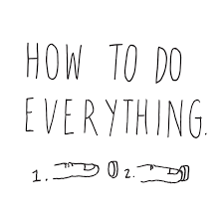
Not a "how-to" guide so much as a "how we did" guide
Notes:
In turn, this entire thing comes from my experience – as a developer, as a “security guy” and running teams that integrated both.
Why the picture? For ourselves and the teams we work with, we want everything to be as easy as pushing a button

Slide 5

Everything revolves around the idea of "minimum necessary access" and "do it securely or don't do it"
Notes:
Minimum necessary access is an important concept
Heard it more in gov than in priv
Exactly what it sounds like “if you shouldn't be there, we don't let you go there”
Do it securely or don't do it at all, because we have the backing to roll back your code, turn off your site, or make you fix it

Slide 6

How did we start?
Worked to understand our security space
Knowing how we could manage our infrastructure was key
Understanding our automation tools from the bottom up
Knowing who would help us inside our organization
Notes:
Security space:
- What did we own? What did our partners own?
- What was our testing and analysis capability?
- What didn't we know that we should?
Infrastructure:
- how it's laid out, how it's deployed, what external touches, and what tools were available
Tools:
- What tools were we using, how were we using them, what capabilities did they have and what were we missing
Who would help: Allies in dev teams, execs, sec teams

Slide 7
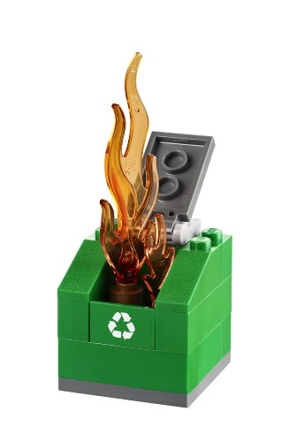
Next steps
We know what we built (image, right)
What we knew we needed: auditable, repeatable process that integrated as fully as possible in to our environment
What could we keep, what could we throw away - and what did we need that was new?
Notes:
Built: Dumpster Fire
- EU/US difference? Tyre Fire vs Dumpster Fire
- It was still doing it's job, but was almost as much work to fix as to manage manually
Needed
What to keep: Keep, toss, find/buy/invent?

Slide 8

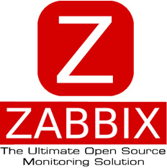


Tools we had
Configuration Management (Chef11)
Monitoring (Zabbix),
Centralised logging (ELK - single node)
Alerting (PagerDuty)
Notes:
Aside from PagerDuty, everything is cutting edge 2012
For sticklers, Chef11 was in beta

Slide 9
Tools we needed
?!
Better monitoring
Better logging
Infrastructure automation
Better configuration management
Auditing
Code management
Notes:
Basically we needed everything, but we weren't necessarily losing what we had in place, we simply needed to move on.

Slide 10
Tools we picked
Git for SCM/GitLab for UI & Access Management
Jenkins for CI/CD
Terraform & Packer for IaC
InSpec for infrastructure configuration testing
Chef12 for Configuration Management
ELK - full HA cluster for logging
Sensu for Monitoring
PagerDuty for Alerting

Slide 11
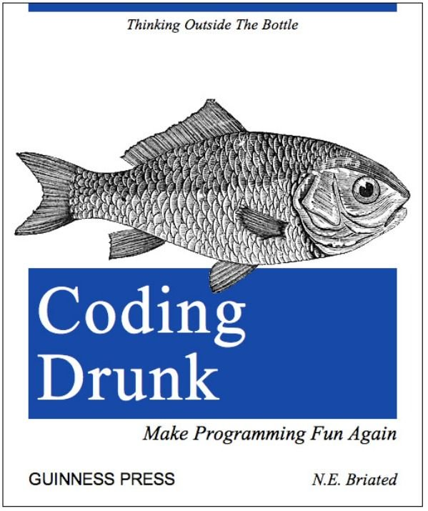
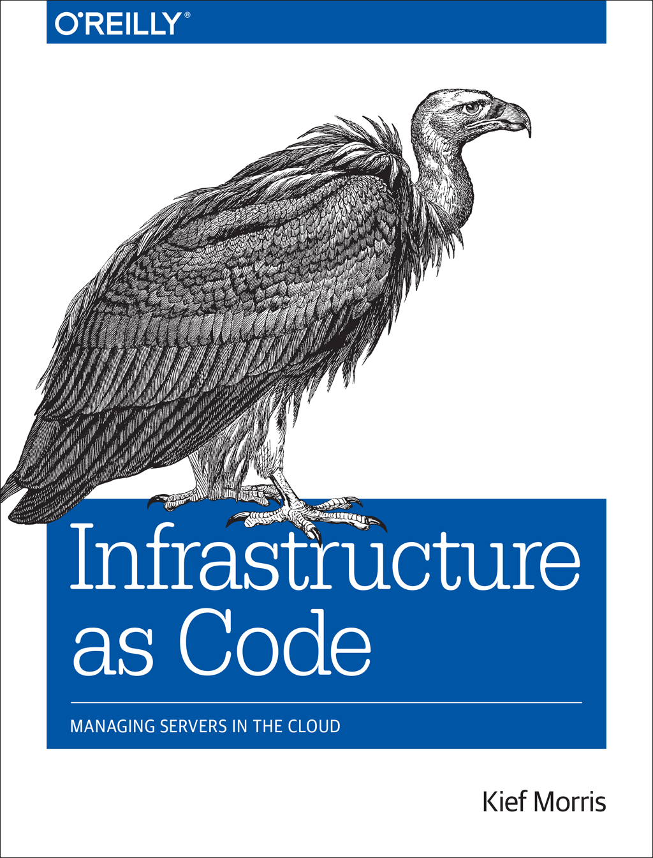
What about the details?
Treat every engineer like a developer
Treat every object in the infrastructure like code
Notes:
Not every developer is a drunk, but many often feel like sometimes they should be
Add managing infrastructure to the mix
Make sure we could code

Slide 12




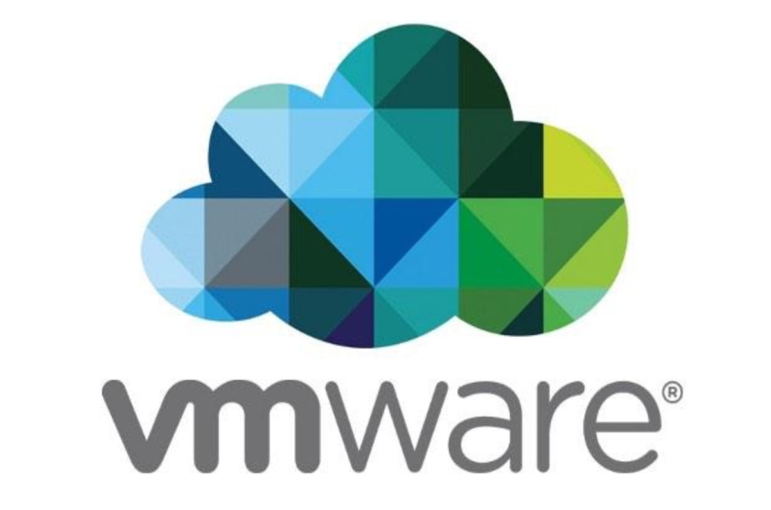
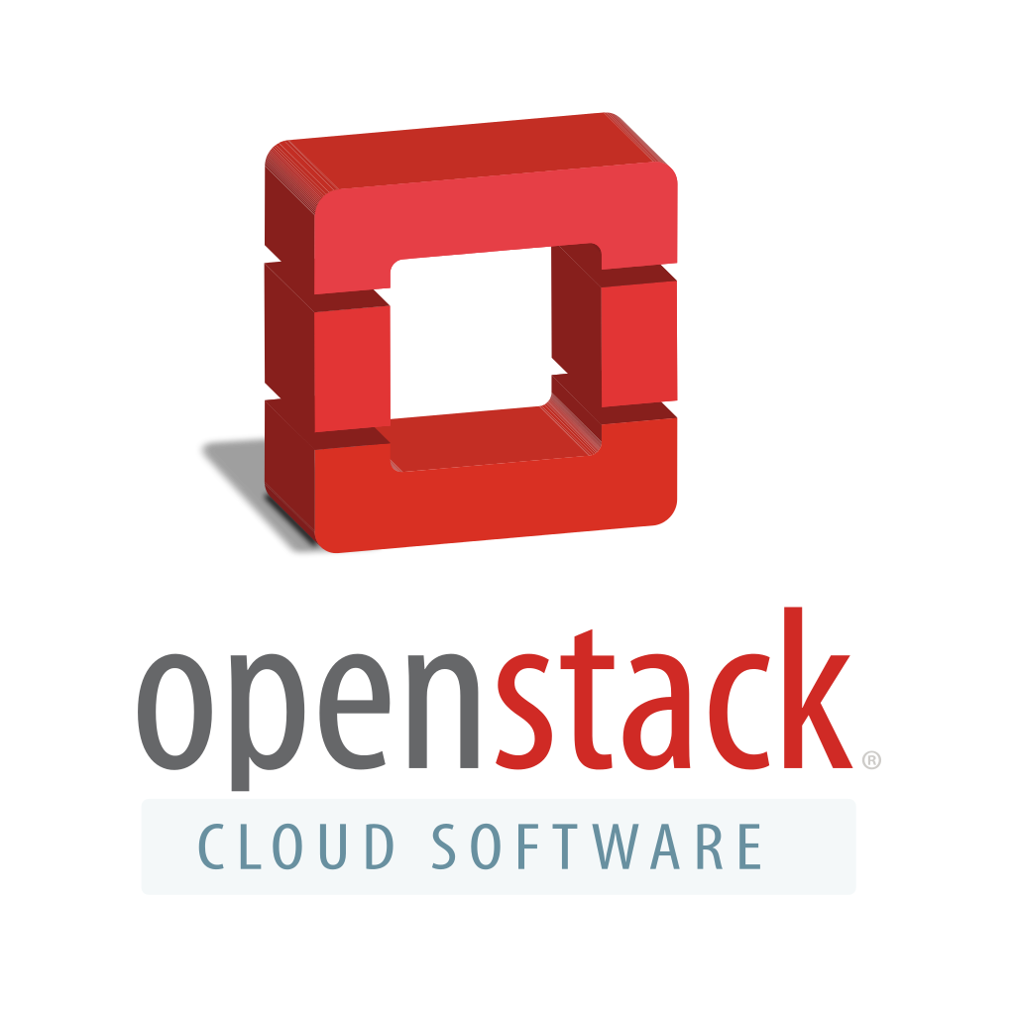
That's great, but how?
Every environment starts with a new group in GitLab and projects initialized with default configurations and build pipelines
Environments are then configured with the appropriate access credentials for the provider
Our providers are legion!
Cloud First class: AWS/Azure
Cloud Second class: Rackspace Cloud, GCE,
On-prem (tertiary): vSphere, OpenStack

Slide 13



Initialisation
Define with Terraform
Created on infrastructure provider
Bootstrapped in to config management
Tested with InSpec for compliance

Slide 14

Configuration
Instances defined in config management (chef12)
Tie instances to monitoring/appropriate checks (sensu)
Log all related data (ELK)

Slide 15

Post-initialisation
All instances are registered for periodic scanning by our security team
Quarterly red teaming

Slide 16
Security
Communications are locked down
https where required,
ssh by default, accounts limited, best practices (key only, no root)
ACLs defined to limit origin traffic
Defined security policy
Client Exceptions require sign off by Security & Client
No Exceptions of internal origin

Slide 17
Security Continued
Minimum necessary access: devs have access to development environments only, non technical personnel have NO access
Infrastructure changes/deployments handled through Jenkins
Code/Applications deployed through whatever build tool the applications team uses (Usually Bamboo or Travis)

Slide 18
What about other security?
Base images built to a hardening standard
Machines are scanned for compliance along the build pipelines
Communication is secured (TLS/SSH/SCP)
Keys are encrypted (GPG) with passwords stored separately
Data objects for configuration management are encrypted

Slide 19
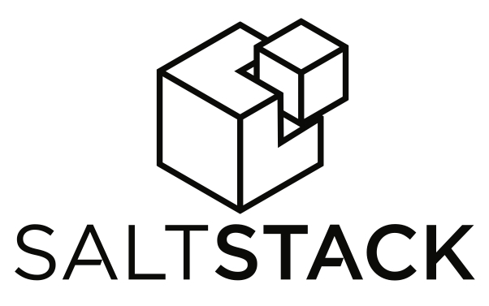




So... why not tool X?
Best internal support (KB, understanding)
Most compatible with other parts of the org
Best trade-offs
Best overall needs for OUR org
You should find what works for you and run with it

Slide 20



Some problems
Lack of client buy-in
Developer demands
Signal v. Noise (Monitoring/Alerting)
Knowledge sharing
Notes:
Clients just don't understand; often oriented to a non-infrastructure, non security focused background.
Use small words – and big references. Target, JPMC, Yahoo
Biggest complaint “we don't have anything of value!” - forget about the value of user data
Developers “ask, ask, ask” a: “not no, here's how” - engage our developer allies to spread the word
SO. MANY. ALERTS. Why? Only send actionable alerts!

Slide 21



THE FUTURE
Better education for both internal orgs and clients
Reduction of noise by tuning our alerts
Better compliance and inspection
Giving back!
Notes:
Along with our security team, running lunch & learns and other educational sessions. Spend one-on-one time with our “problem children”
Tuning alerts, no one wants to be woken up for useless problems. Better, for client requested alerts, require client to be alerted.
Rewriting our compliance documentation as well as making sure that our automated test follow that documentation!

Slide 22
Thank you!

